Slide 1
Project Management (in Software Engineering)
An Introduction

Slide 2
Getting Started
Projects:
A project is a one-time effort to achieve a particular goal, subject to time and/or budget constraints
In Contrast:
Ongoing activities and/or activities that do not have constraints are not projects
Management:
Management is the activity of assembling, directing, and/or supporting human and other resources in achieving substantial goals

Slide 3
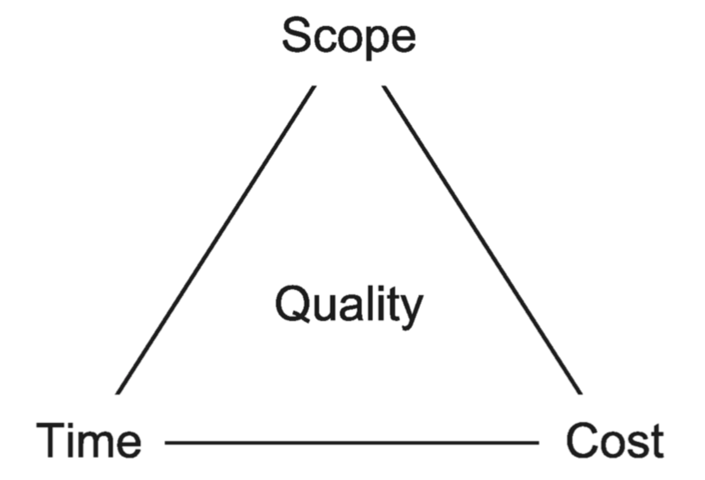
Management Issues
Scope:
The work to be done in the project
Time:
A constraint (and, hence, a resource to be monitored)
Cost:
A constraint (and, hence, a resource to be monitored)
Project Management Iron Triangle
Brooks’ Law states that adding programmers
to a late project makes it later.
Notes:
It takes some time for the people added to a project to become productive.
Communication overheads increase as the number of people increases
Limited divisibility of tasks

Slide 4
Management Issues (cont.)
Quality:
Either a part of the goal of the project or a constraint
Resources:
Things that must be "obtained" and ready when needed in order to complete the project
Risks:
Uncertain conditions/circumstances that have negative consequences

Slide 5
Management Activities
Plan:
Set goals, establish constraints, set requirements, determine tasks, estimate costs, formulate schedules, assign resources, manage risks
Execute:
Acquire resources, train/educate, establish processes
Control:
Collect data, analyze data, report on progress, adjust scope/schedule/budget
Lead:
Motivate, facilitate, resolve conflicts, remove obstacles

Slide 6
Management Responsibilities
Traditional Processes:
Management responsibilities are assigned to project managers who are given the responsibility and authority to collect data, make decisions, and control resources
Agile Processes:
Reduce the need for oversight and distribute authority and responsibility for most activities to the team, though there are exception (e.g., in Scrum leadership activities are the province of the Scrum Master)
Notes:
Section 2

Slide 7
Planning
Terminology:
Milestone - any significant event in a project
Deliverable - any document, program, data, service, or object produced for an internal or external customer
Scheduling - deciding when a task will occur
Resource Allocation - deciding which people/resources will be used for which tasks
Traditional Processes:
Most planning activities occur "up front"
Agile Processes:
Planning occurs at the start of each increment
Notes:
Section 1

Slide 8
Planning (cont.)
Organizing Deliverables:
Work Breakdown Structure (WBS) - a hierarchical decomposition of the work needed to produce deliverables (where the leaf nodes are called work packages requiring between 8 and 80 person-hours)
Scheduling Tools:
Program Evaluation and Review Technique (PERT)
Critical Path Methods (CPM)
Gantt Charts

Slide 9
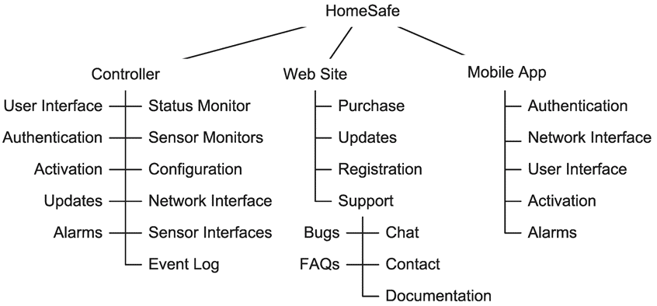
Planning (cont.)
An Example of a Work Breakdown Structure for the Product HomeSafe

Slide 10
Execution
Traditional Processes:
Project managers are responsible for and have the authority needed for execution activities
Agile Processes:
The team is responsible for and has the authority needed for execution activities

Slide 11
Control
Traditional Processes:
Project managers are responsible for monitoring and making changes to the plan (though the changes should be made in consultation with stakeholders)
Agile Processes:
The team uses burn charts to track progress and makes changes usually at the end of an increment (e.g., during the Sprint Retrospective in Scrum)

Slide 12
Leadership
Traditional Processes:
Project managers are responsible for leadership activities
Agile Processes:
Vary in who has responsibility for leadership activities (e.g., in Scrum it is the Scrum Master)

Slide 13
Project Progress Tracking

Slide 14
Motivation
The Objective:
Track the progress of a project
Some Obvious Metrics:
Size
Time
Money

Slide 15
A Common Mistake
An Obvious Way to Proceed:
Compare the actual amount of time used or money expended to the planned amount (e.g., the plan was that the project would require 80 hours and we have used 40 hours so we have completed 50% of the project)
Shortcomings of this Approach:
The planned amount (whether measured in time or money) may have been overestimated or underestimated
The planned drawdown rate may not have been linear over time (so, just because we have spent 50% of the budget may not mean that the project is 50% complete, even if the original estimate was correct)

Slide 16
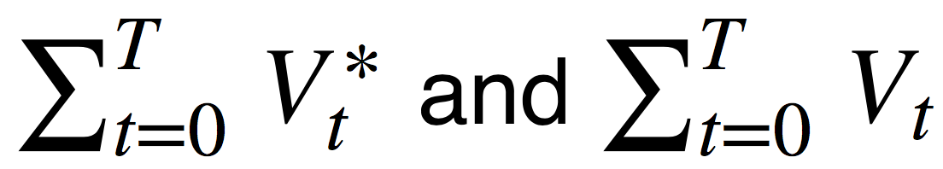
A Better Approach - Earned Value Analysis
The Concept:
Use a quantifiable measure of progress (called the value)
Compare the planned value with the earned value over time
The Process:
Before the project starts, use the project plan to calculate the planned value for each period, V_{t}*
While the project is underway, calculate the actual value for each period, V_{t}
Compare over time

Slide 17
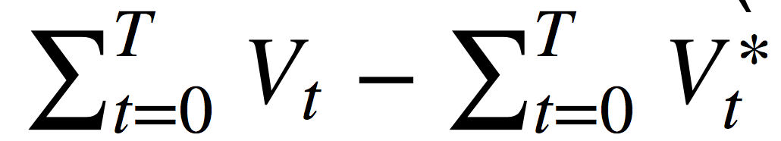
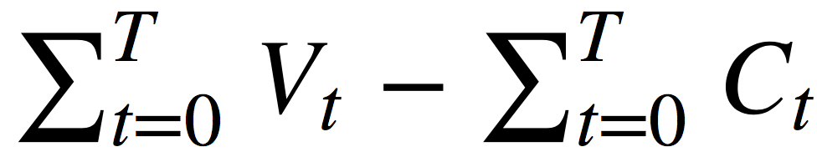
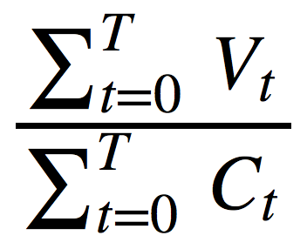
Earned Value Analysis (cont.)
Possible Measures of Value:
The number of completed features
The normalized number of completed features (sometimes called story points)
The monetary business value of completed features
Metrics:
Schedule Variance (in value units not time units):
Cost Variance: ∑Tt=0Vt−∑Tt=0Ct where V_{t} is measured in dollars and C_{t} denotes the costs incurred during period t
Cost Performance Index:

Slide 18
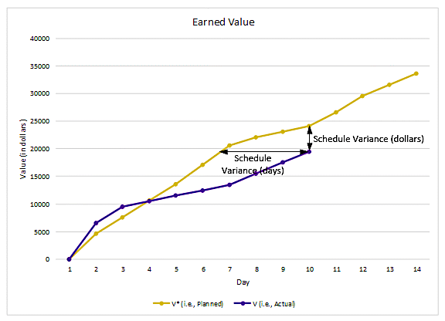
Earned Value Analysis (cont.)
An Example

Slide 19
Burn Charts for Earned Value Analysis
Purpose:
Show the planned and earned value over time
Types:
Burn-up charts show how much value has been completed
Burn-down charts show home much value remains to be completed

Slide 20
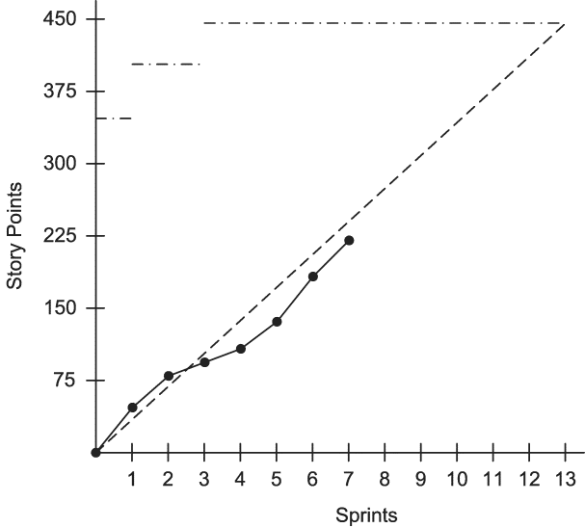
An Example Burn-Up Chart
The State of the Project after the 7th Sprint:
Interpretation:
13 sprints are planned.
The number of story points was increased from 350 to 425 to 450.
Since story points are a measure of effort and the team completes work at a constant rate, the dashed line shows expectations.
The project started well but has fallen behind.

Slide 21
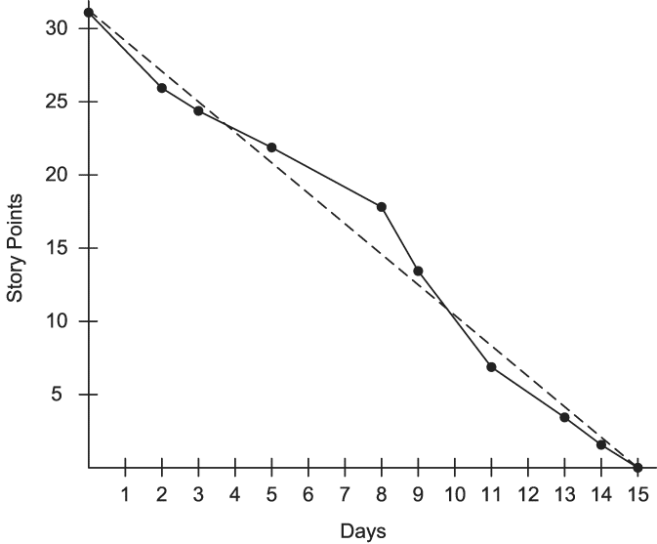
An Example Burn-Down Chart
The State of the Project during a 15-day Sprint:
Interpretation:
The sprint backlog started with 31 story points worth of PBIs.
At the end of day 2, PBIs with a total size of 5 story points had been completed.
At the end of day 3, PBIs with a total size of 2 story points had been completed.
No more story points were completed until day 5, at which time 2 were completed.

Slide 22
